Slide 1


Dec
Jan
Nov
Feb
Egg Laying
Nestlings
Oct
Mar
Dependent young
Young dispersing
Sep
Apr
Wintering
Territorial calling
Aug
May
Adult moulting
Jul
Jun

Slide 2
First Check
Second Check
Third Check
Egg in the box
Breeding failed
Checking boxes
Chicks in the box
Catching adults
Ringing chicks
Mar | Apr | May | Jun

Slide 3

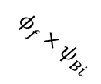



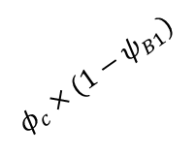



$$φ_{f}×(1−ψ_{Bi})$$
Floater
$$φ_{a}×ψ_{BB}$$
$$φ_{a}×(1−ψ_{NB})$$
$$φ_{f}{×ψ}_{Bi}$$
$$φ_{c}×{(1−ψ}_{B1})$$
Chick
Breeder
$$φ_{a}×(1−ψ_{BB})$$
Non-Breeder
$$φ_{c}×ψ_{B1}$$
$$φ_{a}×ψ_{NB}$$
$$φ_{a}×ψ_{BB}×f$$

Slide 4
Unknown of existence
Predation Pressure
Negative relationship
Positive relationship
Unknown relationship
Age of Parent
Breeding Success
Adult Mortality
Parental Care
Mate Availability
Vole Abundance
Vacancy
Delay Breeding
Early Experience
Habitat Quality
Natal Dispersal Distance

Slide 5
Case 1: If individuals stayed where they first settled = there would be no difference between the ages
Case 2: If individuals keep wondering after the first settlement = same year born floater will have different distance by age
Unknown of existence
Predation Pressure
Negative relationship
Positive relationship
Unknown relationship
Age of Parent
Breeding Success
Adult Mortality
Parental Care
Mate Availability
Vole Abundance
Vacancy
Vole Abundance
Delay Breeding
Early Experience
Habitat Quality
Natal Dispersal Distance
Natal Dispersal Distance

Slide 6
Case 1: if individuals stayed where they first settled = there will be no difference between the age
Case 2: if individuals keep wondering after the first settlement = same year born floater will have different distance by age
Unknown of existence
Predation Pressure
Negative relationship
Positive relationship
Unknown relationship
Age of Parent
Breeding Success
Adult Mortality
Parental Care
Mate Availability
Vole Abundance
Vacancy
Vole Abundance
Delay Breeding
Delay Breeding
Early Experience
Habitat Quality
Natal Dispersal Distance
Natal Dispersal Distance

Slide 7
Case 1: if individuals stayed where they first settled = there will be no difference between the age
Case 2: if individuals keep wondering after the first settlement = same year born floater will have different distance by age
Unknown of existence
Predation Pressure
Negative relationship
Positive relationship
Unknown relationship
Age of Parent
Breeding Success
Adult Mortality
Adult Mortality
Parental Care
Mate Availability
Vole Abundance
Vacancy
Vole Abundance
Delay Breeding
Delay Breeding
Early Experience
Habitat Quality
Natal Dispersal Distance
Natal Dispersal Distance

Slide 8
Case 1: If individuals stayed where they first settled = the vacancy years of owls born would impact more than the vacancy just before their first breeding
Case 2: if individuals keep wondering after the first settlement = the vacancy years of owls born would impact less than the vacancy just before their first breeding
Unknown of existence
Predation Pressure
Negative relationship
Positive relationship
Unknown relationship
Age of Parent
Breeding Success
Breeding Success
Adult Mortality
Adult Mortality
Parental Care
Mate Availability
Vacancy
Vole Abundance
Vacancy
Vole Abundance
Delay Breeding
Early Experience
Habitat Quality
Natal Dispersal Distance
Natal Dispersal Distance

Slide 9



Slide 11

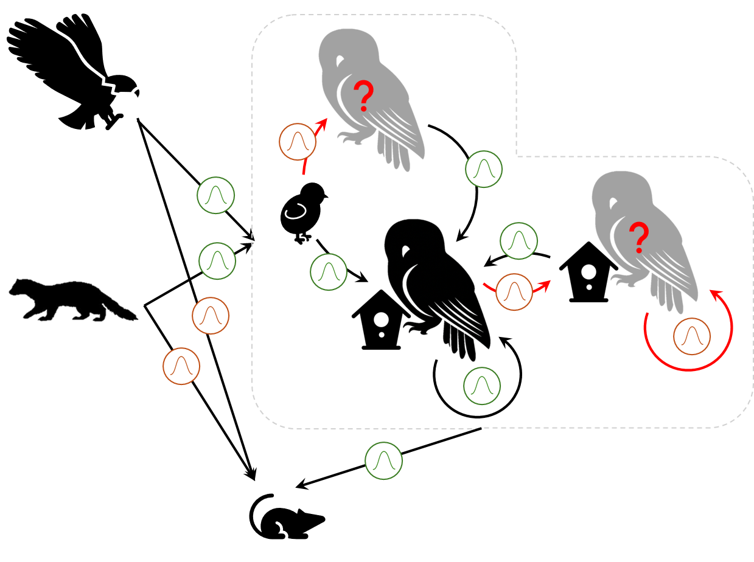


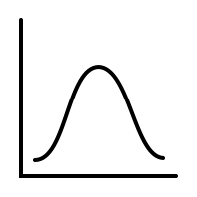





Slide 12

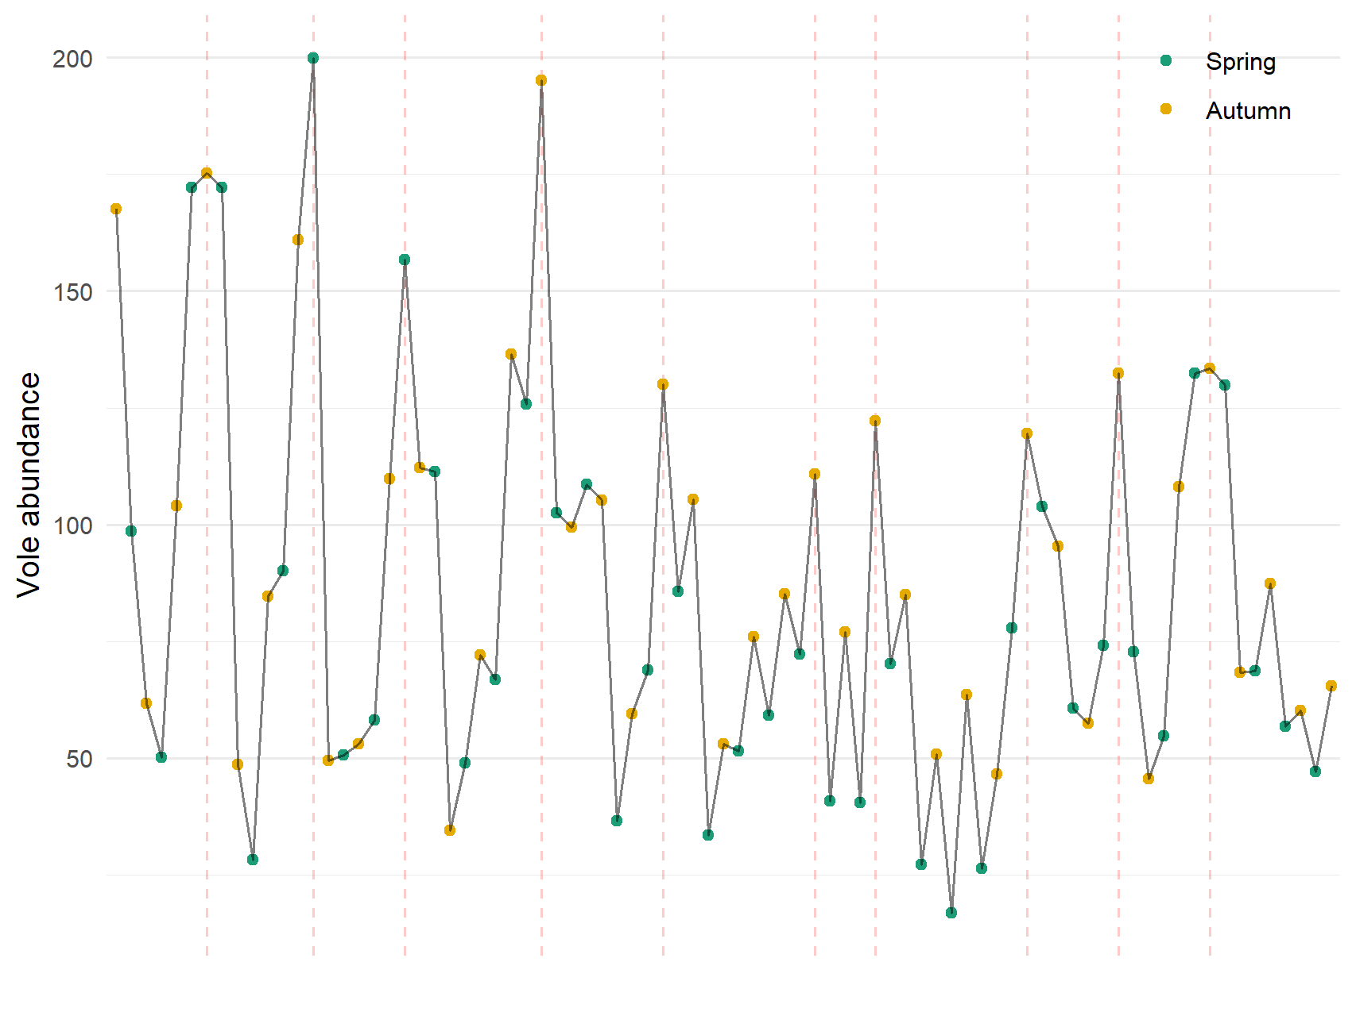
Average between
1987
1991
1994
1998
2002
2007
2009
2014
2017
2020
Leave natal box
Start breeding
Year

Slide 13


